Slide 1
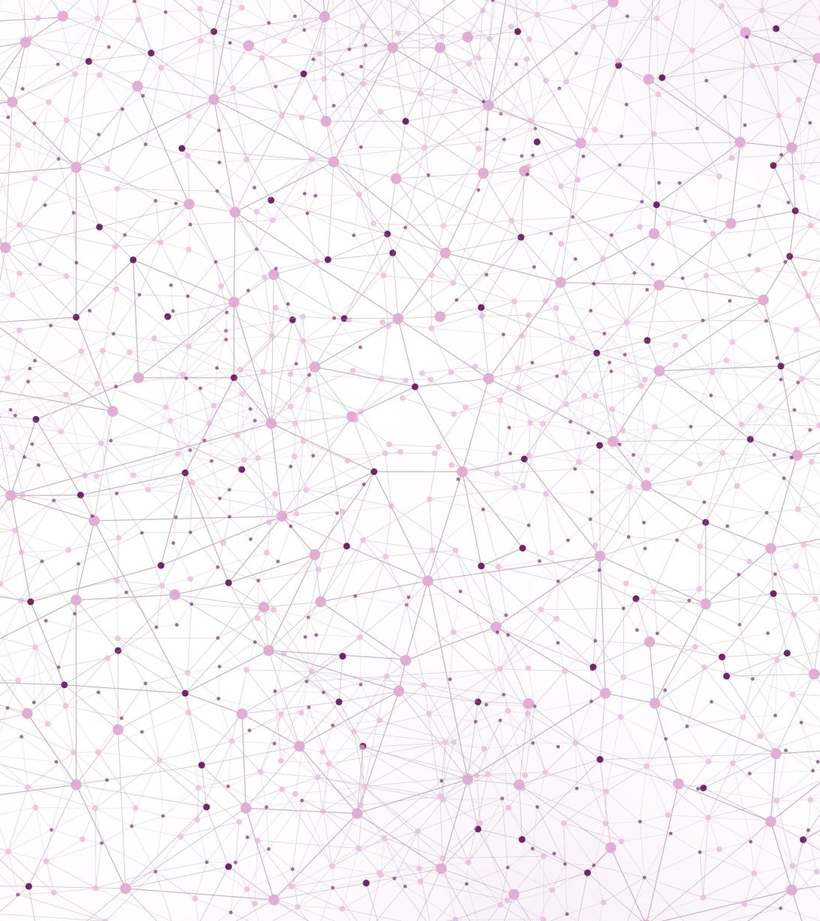
Selected 2 Project Presentation

Slide 2

Architecture used in the Paper

Slide 3
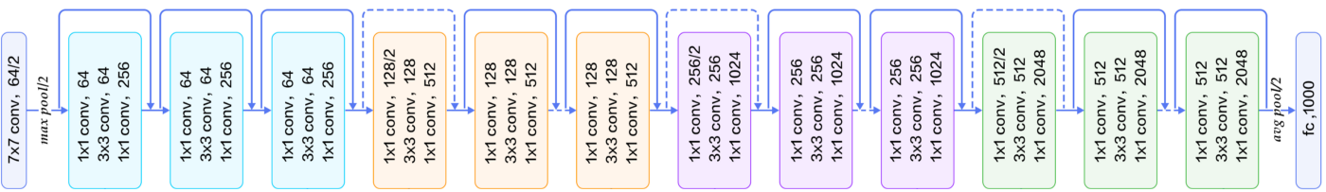
Resnet-50
Model trained on ImageNet Dataset

Slide 4


Dataset details

Slide 5

🌸|Flowers
The dataset contains images of 16 different flowers species.
Total number of Images: 15740
(239 MB)

Slide 6

Implementation details

Slide 7
Data Preproccesing
Resize Images to (128px,128px)
Training Data: 72%
Validation Data: 18%
Loading the Images with colors (RGB)
Testing Data: 10%

Slide 8
Hyper parameters
Hyper parameters | Model before optimization | Model after optimization
Pretrained model | ResNet50 | ResNet50
weights | ImageNet | ImageNet
Pooling | max | average
Top layers | Dense(32, activation='tanh’) Dense(16, activation='softmax') | Dense(160, activation='relu') Dense(16, activation='softmax')
epochs | 4 | 7

Slide 9

Results and visualizations

Slide 10
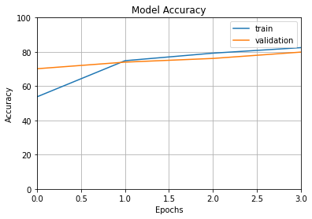
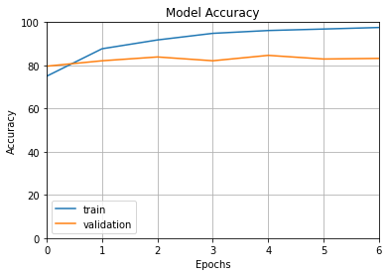
Before Optimization
After Optimization
Training Accuracy: 82.4%
Validation Accuracy: 79%
Testing Accuracy: 80%
Training Accuracy: 97.5%
Validation Accuracy: 83%
Testing Accuracy: 85%

